Slide 1

Coding Careers in Texas
Contributors:
Samantha Brown,
Uma Yeruva,
Ahmed Dahham &
Julia Lira

Slide 2

PRESENTATION OUTLINE
HYPOTHESIS
DATA ANALYSIS
-Opportunity
-Pay
-Location
CONCLUSION

Slide 3

HYPOTHESIS– Original vs Texas Focus
Original Hypothesis: The data career field is an emerging field with good salary and job prospects
Review 2 shifts the focus specifically to Texas utilizing PostgreSQL …
Analysis will include data from :
Glassdoor ( 2018-2020)
Department of Labor ( multiple databases from 2020)
Opportunities Pay Location
ETL ( Extract , transform and load) – database screenshots have been added to appendix.

Slide 4
OPPORTUNITIES
Industry Sectors | Count
IT Services | 472
Staffing & Outsourcing | 313
Biotech & Pharmaceuticals | 293
Computer Hardware & Software | 264
Internet | 238
Health Care Services & Hospitals | 197
Consulting | 166
Enterprise Software & Network Solutions | 150
Investment Banking & Asset Management | 109
Advertising & Marketing | 93
Insurance Carriers | 91
Colleges & Universities | 84

Slide 5
PAY

Slide 6
LOCATION
Texas | Job Count
Austin, TX | 345
Houston, TX | 219
Dallas, TX | 180
San Antonio, TX | 177

Slide 7

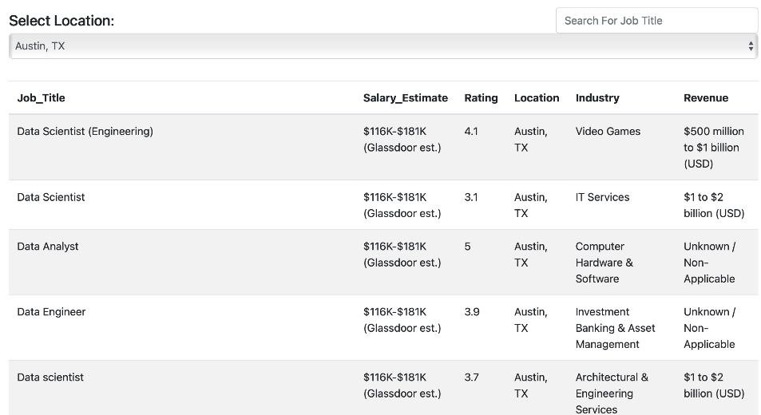
Creating an interactive website to search for opportunities in Texas’s top 10 cities
www. website address….

Slide 8

TESTIMONIALS
“ Knowledge of code allows more control in quality of data Able to apply more advanced statistical methods to research.”
- Biostatistician & Epidemiologist - Austin, Tx
“It is a passion! One can do so much with coding, it is mind boggling – and it pays well.”
- Senior Software Geospatial Engineer / Data Scientist - Houston, Tx
“Lazy programmers are good programmers. We find any way not to do things twice”
- Senior Systems Analyst - San Antonio, Tx
“I enjoy the rush of the challenge that comes along very frequently to learn a new skill that is necessary to overcome some obstacle”
- Rufel Estrada, Instructor – UTSA Data Analytics Bootcamp - San Antonio, Tx

Slide 9

CONCLUSIONS
The data career field has a high average and maximum salary potential
The are no shortage of opportunities people who enter the career field
Texas seems to have abundant jobs in major cities, with Austin, TX being the highest
To reach the higher end of the pay scale applicants may need to seek at least a bachelor’s degree
Excel, Python and SQL knowledge are the most demanded skill sets

Slide 10

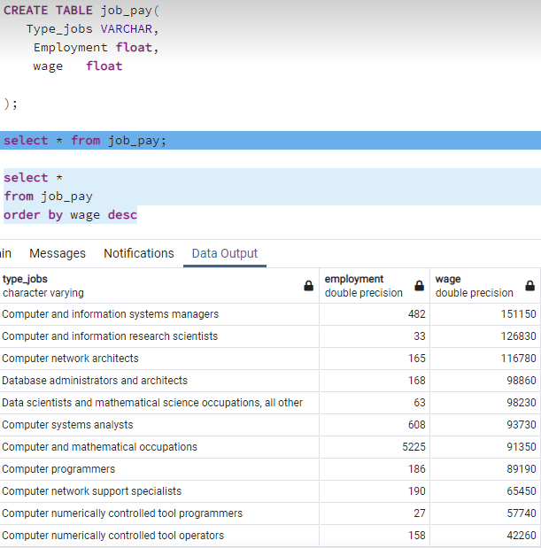
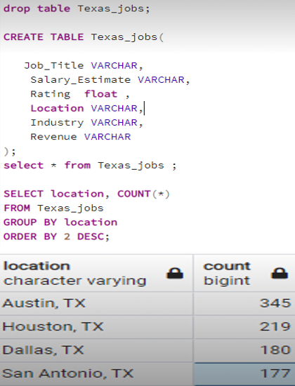
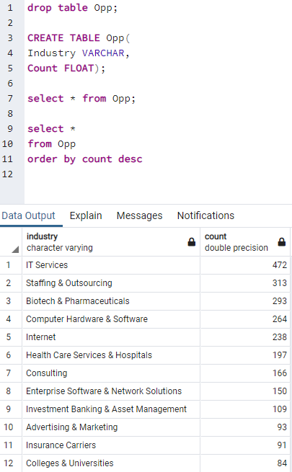
APPENDIX

